Slide 1
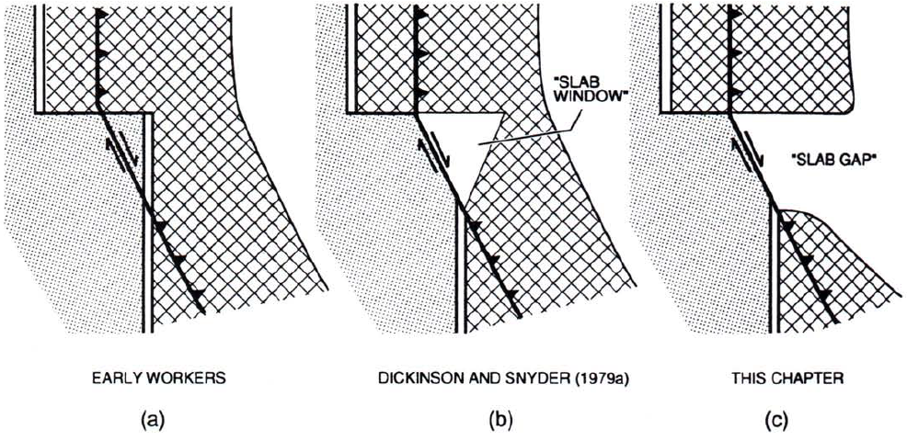
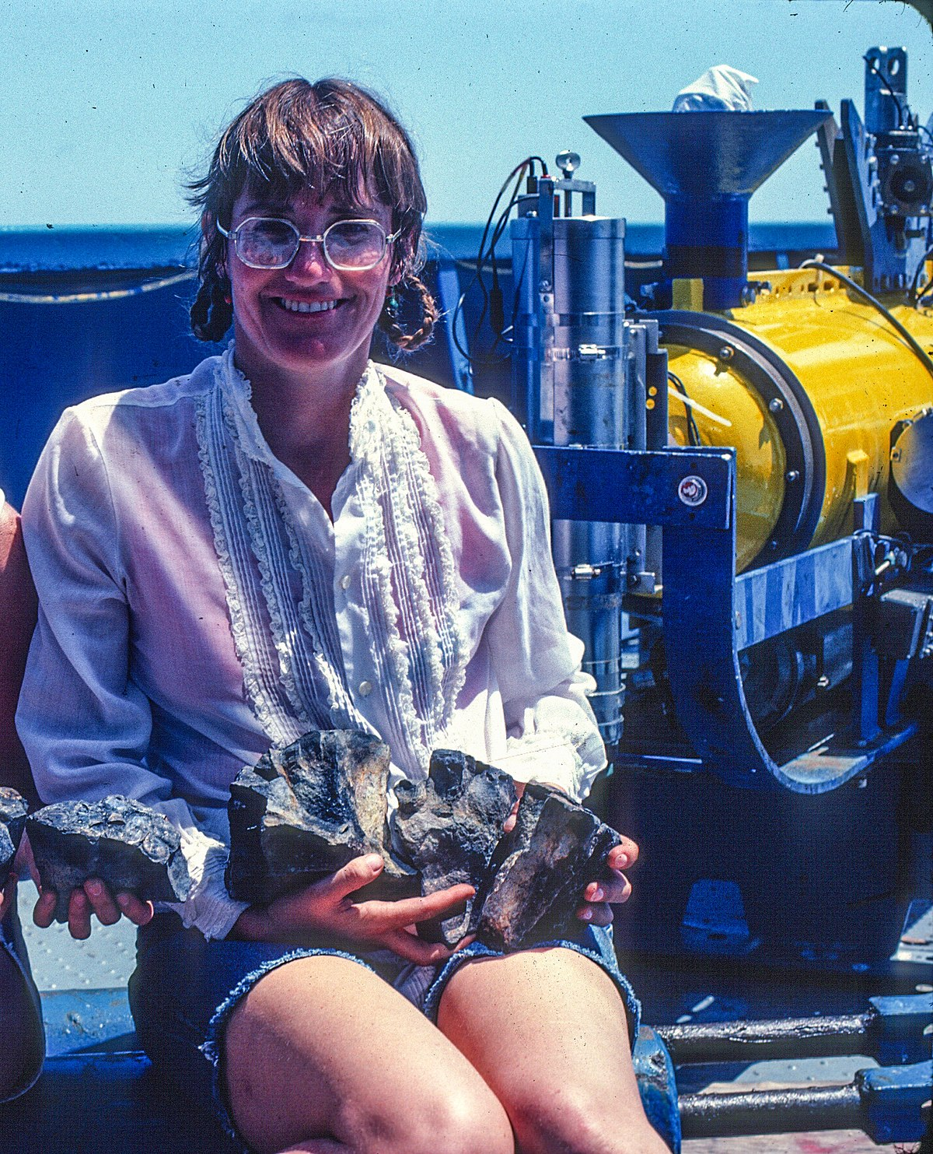
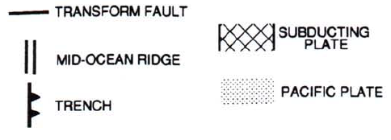
Cenozoic geometry and thermal state of the subducting slabs beneath western North America
Severinghaus & Atwater, 1990
Question Dickinson & Snyder’s theory that lithosphere is coherent indefinitely
Propose development of “slab gap”
Region of no slab bordered by slabs to north and south
Slab fragmentation occurred prior to ridge arriving at trench, i.e. there was never slab in this region
Too young, hot, and weak
Earlier and inland of theorized window
Her majesty Tanya Atwater
Notes:
Dickinson & Snyder proposed “slap gap” (see Ian’s presentation for more info); this study builds on their research and proposes that the slab in this area was too young, hot and weak (ditto), so it fragmented before even reaching the trench (i.e. before the window began to form)

Slide 2
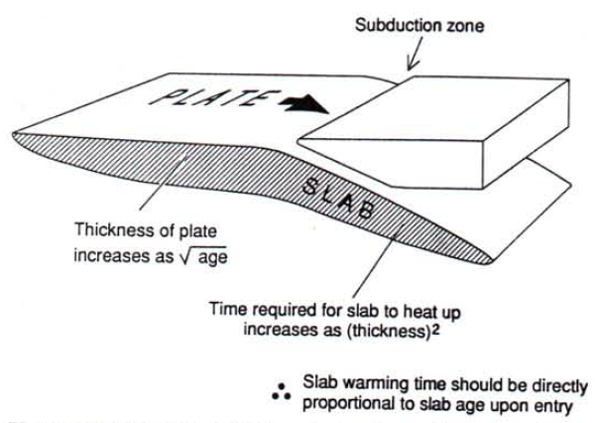
Purpose
How long do slabs stay coherent after subduction?
Goal: map paleo extent of coherent subducting slabs beneath N. America
Need to know the point where the slab becomes too warm or becomes incapable of inducing tectonism/volcanism above
Parameter S: the thermal state of a slab
Assimilation point probably S = 3 or 5, up to S = 10
Point where slab assimilates
Ex. At S=2, slab has been subducted 2x as long as needed to become aseismic at that point
Thermal state of slab can be characterized if time since entry and age of slab upon subduction are known
Notes:
So anything beyond S=3 is likely not a strong/coherent slab

Slide 3
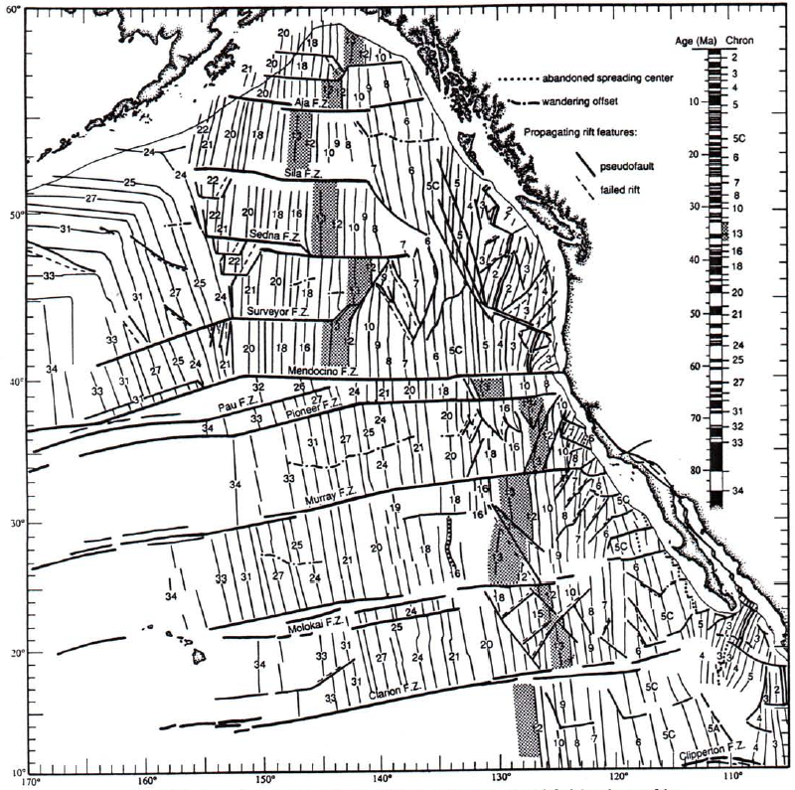
Clues from Seafloor Spreading
Isochrons suggest Farallon plate was broken up throughout Cenozoic
Fragmented into several smaller pieces as it approached trench
Northern and southern plates acted independently (Vancouver and Farallon)
Triple junction: Pacific-Vancouver-Farallon
Zig-zag offsets between 40-35 Ma indicates multiple N and S migrations
Suggests shearing/fragmentation was occurring
i.e. sheared lithosphere being delivered to slab gap region long before gap appeared
Fragmentation became more severe at 30 Ma
Magnetic reversal isochron numbers; shaded area is sea floor formed at 35 Ma to demonstrate early Cenozoic shape of East Pacific rise.

Slide 4
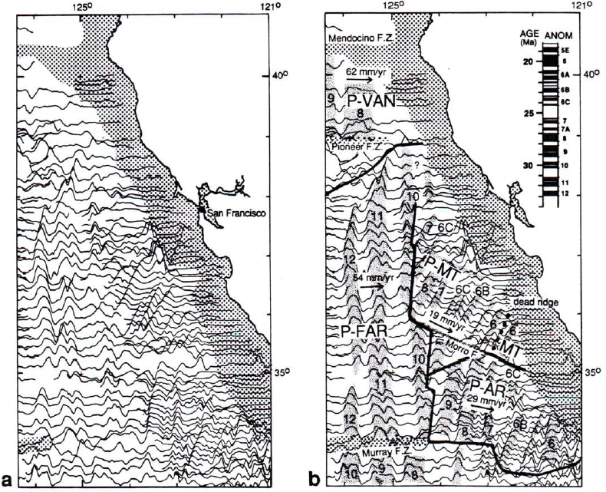
Big Change at 30 Ma
Fast eastward motion abruptly changes to slow, SE motion (wrt Pacific plate)
i.e., slowed as approached trench
Visible in anomalies <10: have NE trend and close spacing
Monterey (MT) and Arguello (AR) plates broke free from Farallon
By 19 Ma Monterey spreading stopped; plate never reached subduction zone
Fast-moving
Slow-moving

Slide 5
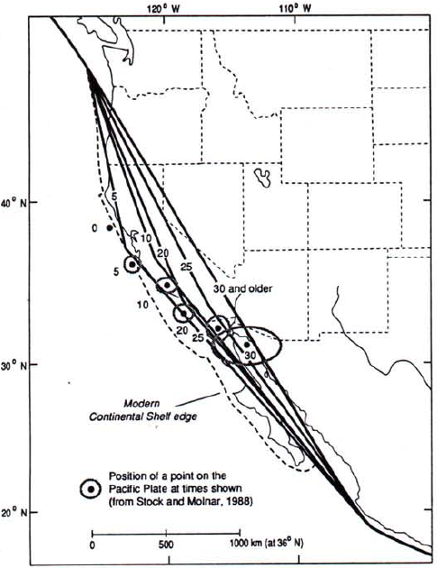
Reconstructing the Shelf Edge
Need approx. location of Cenozoic edge of N. America to map thermal states
Trench position changed as Basin and Range extended and transform faulting began
Predicted timing and extent of continental deformation using “global circuit” (??)
Imagine the dot (MTJ) is the same distance from shelf edge through time
Pin two points to stable north America
Coastline distends through time
Reflective of combined B&R extension and deformation in California
Notes:
Mouths of Columbia river and gulf of California

Slide 6
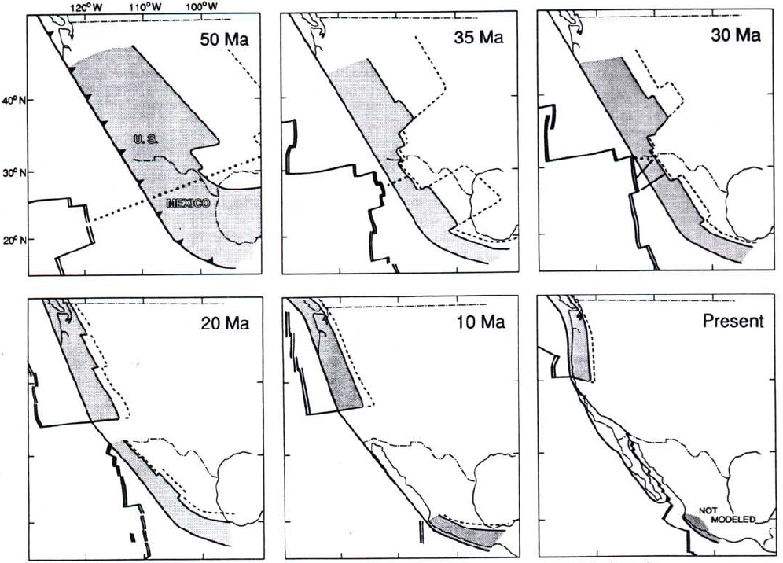
Results
Slab was long, cold, likely shallow pre-50 Ma
Extended all the way to Colorado
Mid-Cenozoic, length of cold slab shortened
Due to younger age upon entry and slower subduction rate
Slab broke up and formed smaller plates (MT and AR) at 30 Ma
Plate movement slowed around 30 Ma
Slab gap formed gradually, developing from the east
N-S widening of slab gap as transform system evolved (SAF)
Continuing to present day
S<2 stippled; S = 3 dashed; dotted lines are approx. location of Van-Farallon plate boundary.

Slide 7
“Plate Tectonics in a Nutshell”

Slide 8
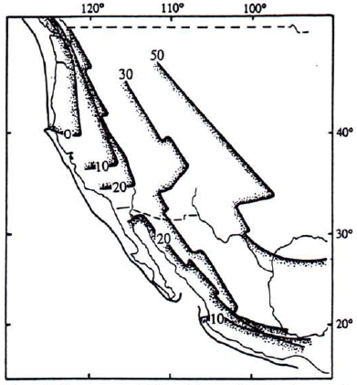
Key Takeaways
~50 Ma: slab long and cold during Laramide Orogeny
Flat slab may have extended to Colorado
Mid-Cenozoic: length of cold slab shortened rapidly
Due to lower age upon entry and slower subduction rate
Slab broke up and formed smaller plates (MT and AR) at 30 Ma
~30 Ma - present: Slab gap developed where the fragmented plates did not reach subduction zone
N-S widening of gap in concert with SAF evolution
Ma
In a few sentences:
Slab gap formed gradually beneath northern Mexico in early-mid Cenozoic.
Shortening of slab and fragmentation occurred as ridge approached trench.
Transition from long cool to short warm slab happened quickly in Paleogene (~35 Ma).
Slab gap continues to widen – related to evolution of SAF.
Whole thing was drifting NW during gap evolution.

Slide 9
How long do slabs last after being subducted?
Slab duration conceptualization:
How long slabs remain capable of inducing arc volcanism/tectonism (too hard to measure)
How long slabs are detectable as mantle seismic velocity anomaly (cold = higher V; can extend hundreds of km beneath slabs)
How long slabs last as a coherent body before disaggregation
Old, cold slabs can be 1000 km long and 680 km deep!
Slabs likely approach mantle temps around S=5 or 7 (velocities become undetectable)
Likely become weak around S = 3

Slide 10
Thermal Reconstructions
Long, cold slab during Laramide Orogeny
600 – 1100 km long!
Average subduction rate 120 ± 20 mm/yr
S = 2 contour means slab has been subducted 2x as long as needed to become aseismic at that point
actual S values unknown; main point is that slab is significantly longer than later in Cenozoic
Heavy numbers = S contours; light numbers = date on entry (Ma).

Slide 11
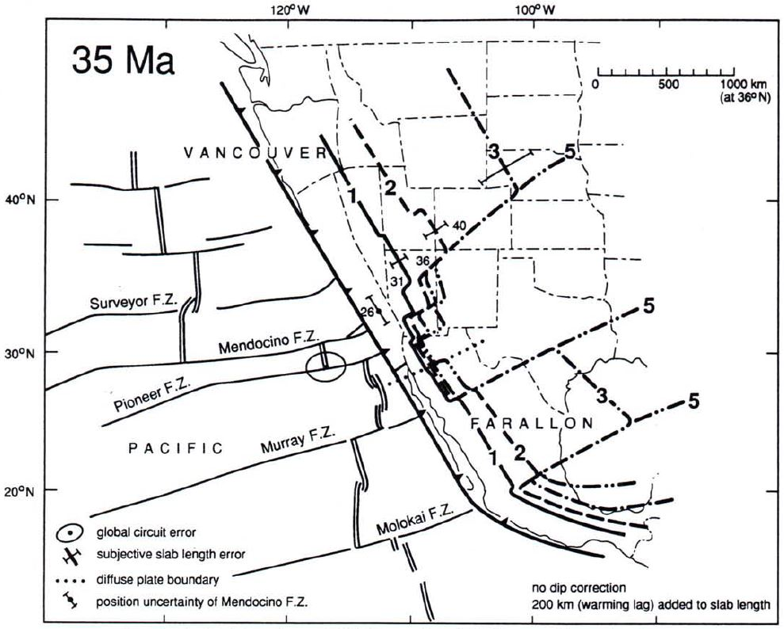
Thermal Reconstructions
Shortening along entire slab
Likely disintegrated “piecemeal” rather than via orderly steepening and slab rollback
Possibly related to mid-Cenozoic westward sweep of magmatism
Slab very short between Pioneer and Murray fracture zones (future area of slab gap)
Inferred that slab was being reassimilated into asthenosphere between N. Mexico and New Mexico
15-20 my before proposed “slab window”

Slide 12
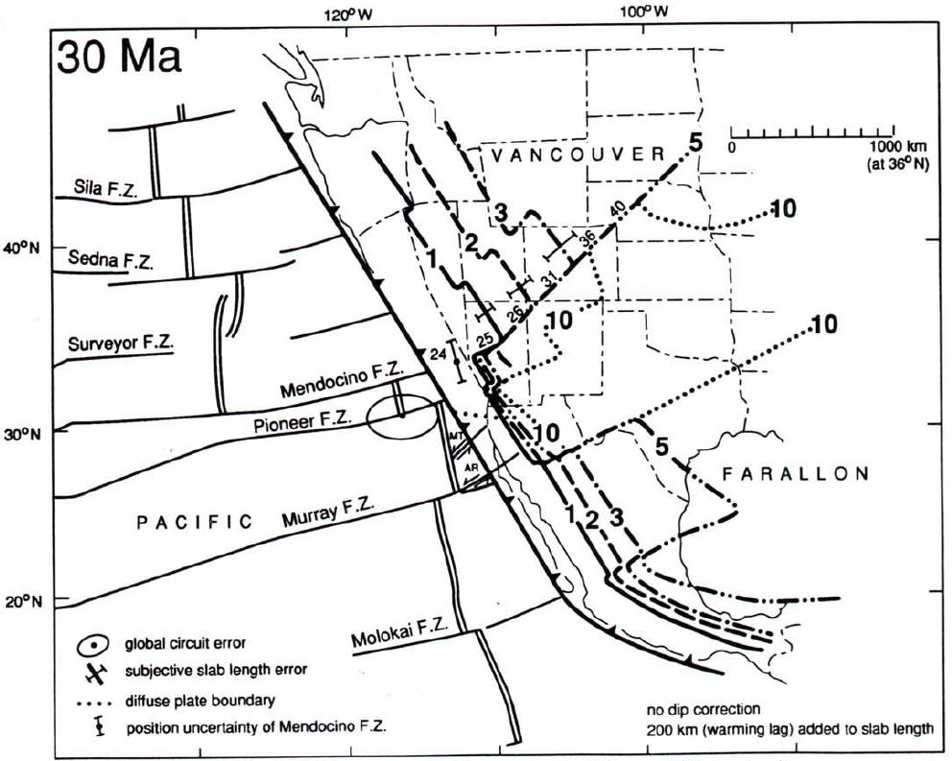
Thermal Reconstructions
Slab between Murray and Pioneer FZs broke off Farallon plate
Likely too thin and warm to remain attached
Smaller Arguello and Monterey plates formed; plate movement slowed
Strike slip movement between plates

Slide 13
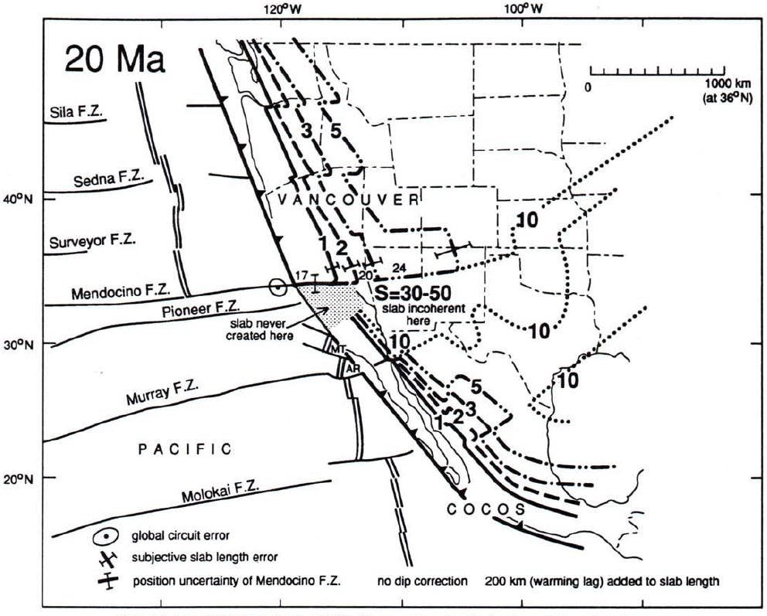
Thermal Reconstructions
Slab south of Mendocino FZ has S = 30-50
i.e., subducted 30-50 times longer than necessary to become aseismic
Indistinguishable from asthenosphere
MT and AR slabs very short
No slab to north of MT and AR slabs

Slide 14
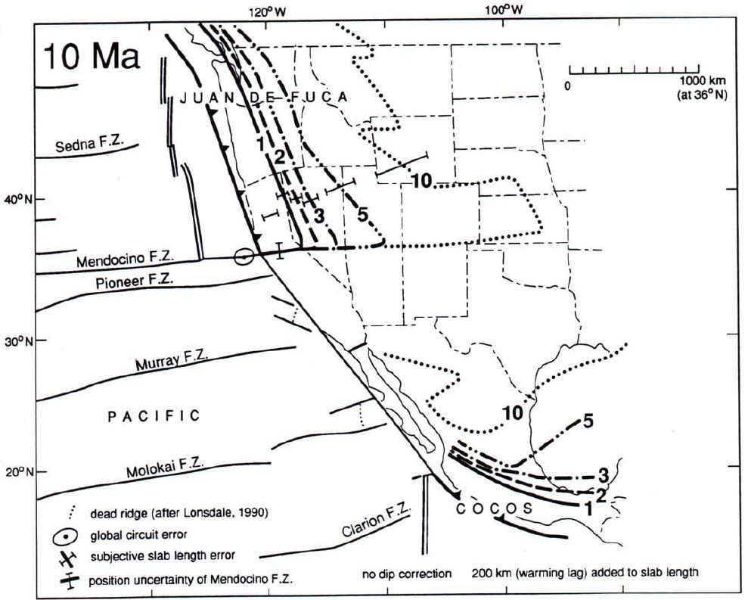
Thermal Reconstructions
East Pacific Rise spreading stopped at ~12 Ma
Offshore of Baja California
Due to southern triple junction jumping south
Assume subduction in this area stopped contemporaneously

Slide 15
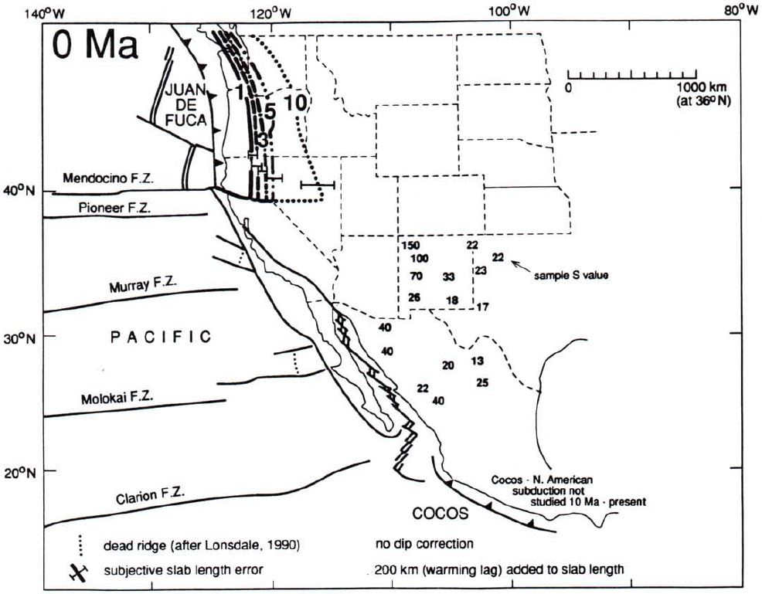
Thermal Reconstructions

